Slide 1
Rationale for Systems Engineering (SE) Tools
Do I have a problem and can an SE tool solve it?
RR011/06: April 2016

Slide 2
Contents
The Problem
Definitions
What is Cradle?
Cradle Benefits
Example Applications
Example Uses
Lifecycle Coverage
Scope
Summary

Slide 3
The Problem 1
Projects are complex, large amounts of information, all inter-linked, held in documents
Documents are a major problem:
They are linear, the information is not
Searching is difficult:
How to find all instances and uses of thousands of pieces of information…?
Searching is slow and inefficient, even in parallel
Difficult to link between documents, maintaining the links is virtually impossible
Contain duplicated information, any change must be made in exactly the same way in all duplicates
Release problems:
Do all users have the same document issue?
Which documents must be re-issued after any change to any one of them?
Uncontrolled - easy to copy, change, and print - even if signed

Slide 4
What is Not the Solution? 1.1
Can Document Management Systems (DMSs), wikis, knowledge bases (KBSs) or other collaboration tools manage complex project information?
Not really…
DMSs provide controlled review and issue of documents
Manage documents as indivisible entities
But should manage the content as related pieces of data
If each document’s contents were disjoint from all others, this might work
But the contents are not disjoint:
The same data appears in several places
Data in one document relates to data in another
Consistency must be maintained as the data changes
Collaboration tools allow information to be entered and inter-related
But lack rigour and structure (that is their intent), so:
Cannot enforce structures and rules
Cannot add characterisations of the data (maturity, priority, scope, level)
Cannot search based on linkage or information types

Slide 5
What is the Solution? 1.2
A system that:
Manages the pieces of data found inside documents
Relates each piece of data to those:
That depend on it
That it is dependent upon
Allows new information to be related to the data already present
Allows the data to be published into documents for customers, users…
Allows full traceability of all changes to all pieces of information
Allows full configuration control of each piece of information
… this is the role of requirements management and systems engineering tools

Slide 6
Definitions 2
3SL is a company that produces Cradle
Cradle is a software tool for requirements management and systems engineering
Requirements Management (RM) is the process of eliciting, documenting, analysing, prioritising and agreeing on requirements and then controlling change and communicating to relevant stakeholders. It is continuous throughout a project. A requirement is a capability to which a project outcome (product or service) should conform.
Systems Engineering (SE) is an interdisciplinary engineering field that focuses on how complex engineering projects should be designed and managed. Issues such as logistics, the coordination of different teams, and automatic control of machinery become more difficult when dealing with large, complex projects. Systems engineering deals with work-processes and tools to handle such projects, and it overlaps with both technical and human-centred disciplines such as control engineering and project management.
Started in aerospace and defence, now widely applied:
Automotive • Construction • Finance
Manufacturing • Medical • Nuclear
Pharmaceuticals • Telecommunications • Transport

Slide 7
What is Cradle? 3
Cradle is a database into which you:
Load any amount of any type of information, from:
Documents (customer specifications, contracts, standards…)
Automatically splitting it into pieces of data (paragraphs, table cells…)
Other tools (Excel, databases…)
Manually entering it
Define relationships between these pieces of data
This is the difference between tools like Cradle from Access, Oracle, MySQL…
Query, view, update and report this data, for:
Coverage, such as: Have we met all customer requirements?
Compliance, such as: How well have we met the customer requirements?
Traceability such as: What do our statements and assertions depend on?
Track and control the evolution of the data
Generate metrics, KPIs, dashboards from the data
Generate documents from the data (such as ITT / RFP responses, SRDs, IRDs…)

Slide 8
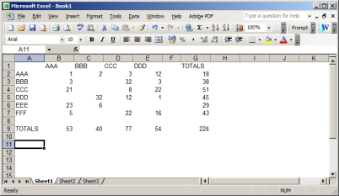
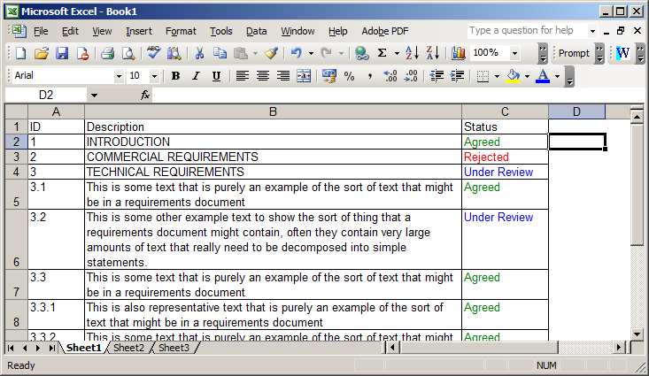
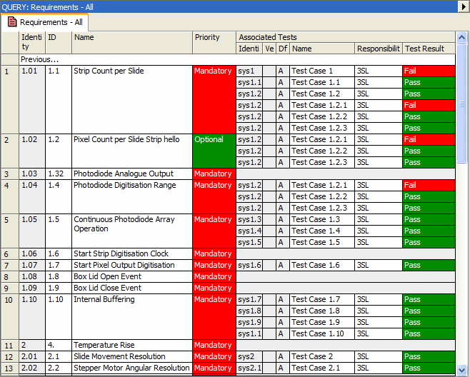
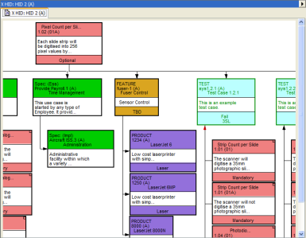
The Big Picture 3.1
Customer documents Standards etc
Excel, CSV, XML data
Output documents:
Bids, URDs, SRDs, SDSs etc
Cradle Database
Compliancy and
Coverage views
RM/SE Tasks:
Load information
Create dependencies
Create traceability
Run metrics
Produce reports
Generate documents
Maintain throughout the entire project
Graphical views

Slide 9
Document Capture 3.2
Source
Documents
User Requirements
Text
Typical database
Doc
Acceptance
Origin
Source
Document
…
Source
Document
Reference
1
2
3
4
Test Method
Status
2.1
2.2
2.3
2.4
2.5
Text
Acceptance
Needs or User
Requirements
…
Needs or User
Requirements
2.3.1
2.3.2
Origin
Reference
Test Method
Status
System
Requirements
Doc
Reason
Rationale
Reference
1
2
3
4
Note
Information for rest of the system lifecycle
2.1
2.2
2.3
2.4
2.5
Reason
2.3.1
2.3.2
Rationale
Reference
Note

Slide 10
Example Bid Database Contents 3.3
From External Sources
Customer
External Regulators
Customer Responses
Customer RFP Documents
Standards
Prime Contractor Data
Consolidated Requirements
Acceptance Criteria
Prime and Subcontractor Data
Technical Questions
Partitioned Requirements
Verifications
Candidate Solutions
Measures of Performance
Justifications
Preferred Solution
QA/QC (Validation)

Slide 11
Example Database Traceability 3.4
Transitive relationships are the indirect links between items of information that can be found by following chains of multiple cross references. This provides end-to-end, cross- lifecycle anywhere-to-anywhere traceability and coverage.
It is unique to Cradle.
User Requirements
Acceptance Criteria
Transitive relationships
Use Cases Analysis Models
Verifications
Transitive relationships
System Requirements
Architecture Models
Transitive relationships
Integration Tests
Design Models
Unit / Module Tests

Slide 12
What Cradle is Not 3.5
Cradle is not a project management (PM) tool:
PM tools process programmes (PERT, Gantt, arrow/precedence networks)
Calculating start/finish times and resource usage
Cradle doesn’t do this
But Cradle projects can have a WBS (Work Breakdown Structure)
Cradle can exchange data bi-directionally with MS Project
Cradle can manage task lists:
Showing each user their tasks and urgency
Users can enter actual progress and send to Project
Cradle manages the data that the PM tool’s programmes’ activities refer to:
Creating / updating / verifying / testing / accepting:
Requirements • Contracts • Designs
Fabrications • Tests • Acceptance
…or whatever you want it to contain

Slide 13
Cradle Benefits 4
Single point of truth:
All information is in one place, so you only need to change it once
Knowable relationships:
You know where every piece of information is used
You know what every piece of information depends on
So you know, for certain, the entire impact of any and every change
Guaranteed consistency and accuracy in all outputs:
Each piece of information exists once
Which guarantees the accuracy and consistency of all outputs:
Reports
Metrics
Documents
that is, of all project deliverables

Slide 14
Cradle Benefits: 2
Access controls:
If you need to restrict access to data, you can
If you want your customer to have visibility of some data, you can
If you need to partition data between you and your customer, you can
If you need to partition data between subcontractors, you can
Automatic change traceability:
You have a complete record of all changes, when, by whom, why and what
The impact of every customer change can be assessed
The propagation of every customer change can be monitored and verified
Automatic development history:
You have a complete record of the bid response and all re-bids
You have a complete record of the as-designed and as-built systems
With full justification for all differences

Slide 15
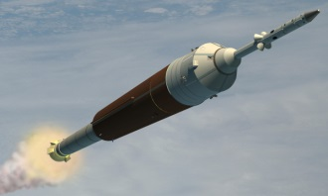
Example Applications 5
Automotive
Space Systems
Operations
EVA / CSSS
Taurus II
Safety & Controls
Consoles
Lighting
Engine
Management
Orion
SLS, Ares V, Altair
COTS
Space Communications
Naval
Astute
Submarine
CVF
Type 45 Destroyer
CVN77
CVNX
Aviation
Tornado GR4
Communications
Construction
E-2C
Harrier GR7/9
Typhoon
Nuclear
F-22
G3 Cellular Networks
Radios
Nimrod MRA4
Roads/Bridges
Air-air Refuelling
Air Traffic Control

Slide 16
Example Uses 6
Tenders/Contractual Statements of Work (SoWs):
Load customer contracts into Cradle, splitting into component statements
Create verifications for each, often many-to-many relationship
Produce bid documentation with compliance statements
Tender/Contractual SoW Assessment:
Define contractual statements
Generate tender documents
Receive responses and load into Cradle, splitting into component statements
Link each set of responses to the tender statements with compliance scores
Automatically analyse responses

Slide 17
Example Uses: 2
Contract Fulfilment:
Load customer contracts into Cradle, splitting into component statements
Create project / design information
Link to statements
Generate design / interface specifications
Automatically identify contract changes in customer updates
Perform impact analysis on each update
Negotiate from a clear understanding of the effects of the changes
Record all changes throughout the process
Satisfy ISO 9000, CMMI requirements
Automatically generate audit logs

Slide 18
Example Uses: 3
Generalising the 2 previous examples: Can be applied over the entire supply chain:
Cradle databases on both sides of a contract boundary are not essential to create a benefit for the side using Cradle
Customer
Level 1 requirements
Generates specifications
Assesses responses
Issues updates
Receives and tracks progress
Customer
Cradle
Cradle
Supplier
Cradle
Supplier
Assesses specifications
Generates responses
Assesses updates
Does work at level N
Reports progress
Acts as customer for next level (same tasks)
Supplier
Cradle
Cradle

Slide 19
Lifecycle Coverage 7
Cradle supports the full lifecycle, providing end-to-end traceability:
Issue Management
Traceability / Coverage
Documentation
Interface Management
Metrics
Risk Management
CM
Access Control
Cradle
Requirements
Acceptance
Analysis
Validation
Systems Engineering
Architecture
Integration Test
Design
Verification
Discipline Point Tools
Engineering Disciplines Mechanical, Electrical, Electronic, Civil, Software
Detailed Design
Module Test
Implementation
Unit Test

Slide 20
Lifecycle Coverage: 2
Both at multiple levels:
and in phased or agile processes:
Analysis
Release
System level
Subsystem level
Component level
.. other levels
Requirements
Acceptance
Architecture
Validation
Analysis
Integration
Design
Verification
Release
Requirements
Implementation
Acceptance
Architecture
Validation
Analysis
Integration
Design
Verification
Release
Requirements
Implementation
Acceptance
Architecture
Validation
Design
Integration
Verification
Implementation
Features
Updates
Specify
Needs
Systems
Analysis
Release
Confirm
Requirements
Acceptance
Architecture
Validation
Design
Integration
Verification
Implementation
Build

Slide 21
Scope 8
Capture and manage requirements, assumptions, justifications…
Create models of use cases, functions, classes, data relationships
Build system-of-systems, system or subsystem architectures
Identify and manage system / subsystem interfaces
Allocate functions to subsystems and equipments
Define performance, AR&M (Availability, Reliability, Maintainability) and effectiveness
Manage System, Product, Work and Cost Breakdown Structures (SBSs, PBSs, WBSs and CBSs) and link to project data
Perform test management at all levels
Automate project documentation
Create traceability across the entire lifecycle
Collect metrics across the entire lifecycle
Configuration manage and control the project
Track all formal changes and/or individual edits
Management information from dashboards, KPIs, burn-down / earned-value charts
Integrate with desktop and specialist tools
Provide customised web environments to project groups

Slide 22
Summary 9
RM / SE tools are uniquely able to manage project information
Eliminates weaknesses and inefficiencies of traditional documents
Do the project work in the RM / SE tool, not in documents, manage contractual relationships, or both
Cradle from 3SL is a RM / SE tool with a unique full lifecycle coverage
Totally reliable and industrially proven
With the power and scalability for any project
Supports any process, including agile and phase-based
Open, flexible architecture
Can integrate external tools and data
Can be the centre of a project’s toolchain, or part of an existing framework

Slide 23
Thank you for time
For more information, please: Visit our website: www.threesl.com or send an e-mail: salesdetails@threesl.com or telephone: UK: +44 (0) 1229 838867 US: +1 256 971 9500

