Slide 1
Cradle Risk Management
Features and Integration
RR023/02: January 2023

Slide 2
Contents
Risk Management
Risk Management Plan
Representation of Risks
Risk Attributes
Working with Risks
Risk Profiles
RISK Licence
Summary

Slide 3
Risk Management 1
A risk is an event which, if it occurs, has an effect on project objective(s), such as cost, completion, timescales, or preventing injury to persons or environmental damage
Risk management is the name for activities to:
Identify and characterise risks and define their priority / severity
Define and implement means to mitigate or eliminate risks
Review the risks and mitigations for continued accuracy and completeness
Review the mitigations for continued relevance and effectiveness
In a Cradle database, risks are often:
A hierarchy of one or more risk registers
Containing the risks
Each risk is often linked to:
Its sources, such as requirements
Its effect, such as on SBS or functions
Risks
Risks
Risks
Requirements
SBS
Requirements
SBS
Requirements
SBS

Slide 4
Risk Management Plan 2
The first risk management task
Defines:
Principles and basis of all risk management work
Representation of risks and related data in Cradle – part of the schema
Includes:
Methodology, becomes Cradle risk schema and procedures surrounding it, such as:
Sources for finding risks and other data (such as user requirements, ConOps)
Risk identification methods (interviews with experts, past projects…)
Risk analysis methods (qualitative and/or quantitative)
Risk sources, items that can originate risks
Risk impacts, items that can be affected / impacted by risks
Representation of mitigations, as attribute or linked items
Allocation of risk responsibilities, to people / groups, as attribute / linked items
Budget, resources and responsibilities for risk activities

Slide 5
Risk Management Plan: 2
Timing, schedules for risk definition, review and monitoring
Risk categorisation, the types or groups of risks
Typically defines structure of risk register(s)
Creates the risk hierarchy = Risk Breakdown Structure (RBS)
Likelihood and impact:
Risk likelihood values and their probabilities – part of the schema
Risk consequence values – part of the schema
Risk magnitude / priority / severity values – part of the schema
Risk Assessment Matrices (RAMs) to set risk priority from its likelihood and consequence. Is stored in risk’s frame and inherited by the risk’s children.

Slide 6
Risk Management Plan: 3
Risk mitigation strategies that are allowed (part of the schema), such as:
Accept The project will accept that the risk may occur and will deal with its consequences if it does occur
Avoid The project will take action to prevent the risk occurring, the extent will be determined by the magnitude / priority / severity of the risk
Transfer The project transfers the risk to another party, for example purchasing insurance
Reduce The project will take some action to reduce the likelihood of the risk occurring but to a lesser extent than Avoid, the extent will be determined by the magnitude / priority / severity of the risk
and the policies for their use and how they are to be mitigated

Slide 7
Risk Management Plan: 4
Risk reporting:
Types of reports, such as risk registers and risk profiles
Recipients
Frequency
Formats, including tabular, document and graphical
Monitoring and tracking
Which people / groups can be given responsibility for risks
Frequency and methods of:
Identifying new risks
Validating existing risks
Risk analysis
Validating risk mitigation strategies and actions
Methods to track risk management activity
Methods and frequency of audits of the risk management activity
Governance of the risk management activity, including audits

Slide 8
Representation of Risks 3
Each risk is an item in the database
You decide how risk mitigations will be managed, either:
As an attribute of the risk:
As items linked to the risk:
Perhaps shared between risks
RISK
Mitigation Strategy
Mitigation
RISK
MITIGATION
Mitigation Strategy
MITIGATION
RISK
Mitigation Strategy
MITIGATION

Slide 9
Representation of Risks: 2
Risks are usually in hierarchies, a RBS, so they have parent/child links
You can link risks to their source / cause / origin:
Typically needs or requirements, or both
You can link risks to items affected if the risk occurs
Typically SBS items or functions in a model
Typical schema for risk management (part of overall schema) is:
HAS CHILD
HAS CHILD
REQUIREMENT
RISK
MITIGATION
IS CAUSED BY
IS MITIGATED BY
HAS EFFECT ON
HAS CHILD
SBS

Slide 10
Risk Attributes 4
Risk attributes are all user-defined, in two groups:
Optional attributes, chosen for your risk management process
Required attributes needed for Cradle’s risk analyses and risk profiles
We recommend that risks are auto-numbered
Suggested optional attributes are:
An ID, for a hierarchical number that positions the risk in the RBS
A name, optional but helpful
A statement or description that summarises the risk
Details of the factors that contribute to the risk
Details of the effects of the risk, if it occurs
Details of the mitigation of the risk, if mitigations are not held separately
A subject (such as build, timing, performance, resource…), so risks can be grouped
A rationale for the risk, why it is as it is and/or why it is not something else
Some notes for the risk

Slide 11
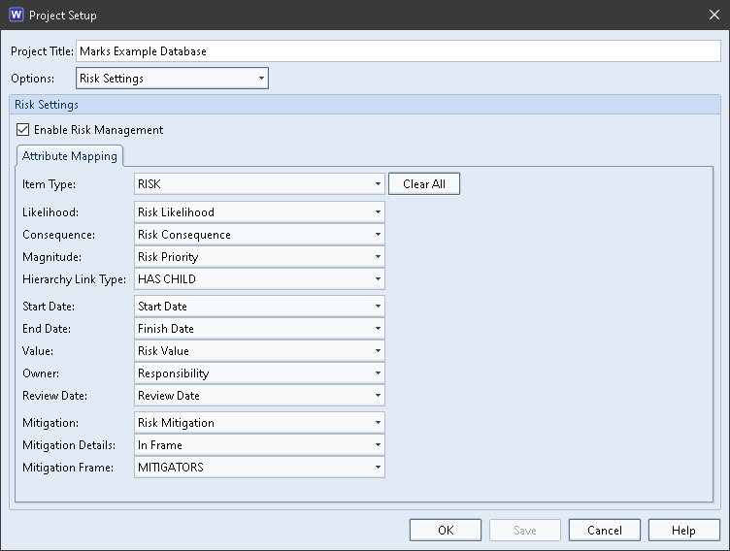
Risk Attributes: 2
Required attributes needed for risk operations are defined in the schema (typically as category codes) and identified in the Risk Settings so Cradle knows the values to use:

Slide 12
Risk Attributes: 3
Risk category, groups of risks, typically represented as a hierarchy, such as:
Risks
Commercial
External
Functional
Health & Safety
Group
Group
Group
Group
Risk
Risk
Risk
Risk
Risk
Risk
Risk
Risk
Risk
Risk
Risk
Risk

Slide 13
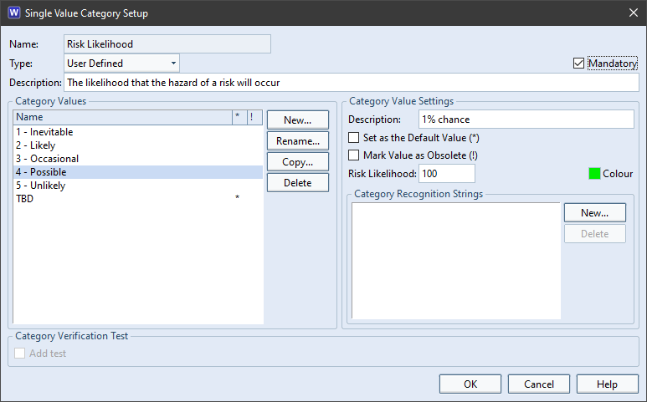
Risk Attributes: 4
Likelihood, how likely is the risk, set of user-defined values, each with a probability
From the Likelihood section in the risk management plan
The values for one axis of a Risk Assessment Matrix (RAM)
Probability specified as N and processed as 1/N
So: 1 = certainty 100 = 1/100 = 1% chance
Consequence, how serious is the risk if it occurs, a set of user defined values
Based on the Consequences section in the risk management plan
The values for the second axis of a RAM

Slide 14
Risk Attributes: 5
Magnitude, the priority or severity of the risk, a set of user defined values:
These values are very important
They define the size / scope / importance of the actions required by the project in response to the risk
Derived from the corresponding section in the risk management plan
Are the values of the cells in all RAM(s)
Set automatically by lookup in a RAM for a risk’s likelihood and consequence
The RAM used is either:
The risk’s own RAM
The RAM inherited by the risk from its parent, grandparent…
Is read-only, it is a calculated value
Hierarchy link type, the type of cross reference to be followed upwards to find a RAM in an ancestor risk in the risk register / RBS
Start Date and End Date, the period when the risk exists, used in risk profiles

Slide 15
Risk Attributes: 6
Risk Assessment Matrix, defines the risk magnitude / priority / severity value for all possible combinations of risk likelihood and consequence:
If a risk has no RAM, it inherits the RAM in its parent risk, or its parent, or its parent… until a RAM is found or the top of the RBS is reached
Likely that different RAMs will be needed for different risk subjects:
Risks related to human injury have far fewer low priority values

Slide 16
Risk Attributes: 7
Responsibility, who is responsible for managing the risk, list of user-defined values
Review Date, a date when the risk should be reviewed according to the Timing and Monitoring and Tracking sections of the risk management plan
Can be used to filter risks needing review
Mitigation, the mitigation strategy for the risk, a set of user-defined values based on the Mitigation section of the risk management plan
Mitigation Details, either In Frame or As Item:
If In Frame, then:
Mitigation Frame, which frame stores the mitigation details for the risk
If As Item, then:
Mitigation Item Type, item type storing the risk’s mitigation details
Mitigation Link Type, type of cross reference between the risk and mitigation

Slide 17
Working with Risks 5
All risk information is held as items:
Such as RISK, MITIGATION, NEED, REQUIREMENT, SBS, FUNCTION
So everything in Cradle for items will also apply to risks:
Access control uses your user-defined access control rules
Operations use standard Cradle mechanisms, such as:
Queries, including nested queries and parametric queries
Views and display Styles, including linked item views, nested tables, view commands, pivot tables, matrices, graphs, metrics, dashboards of KPIs
Forms including user-defined commands
Making new items with New, New Child, New Sibling, New Hierarchy
Copy, Delete, Properties, Split, Merge, Reorder
User-defined workflows, Advance, baselines, formal changes in Cradle’s CM
Risks can be captured from source documents
All risk information can be published in reports and documents
Risks can be accessed through the API and WSI

Slide 18
Working with Risks: 2
Benefits:
Users work with risks in same way as all other information
No need to learn special functionality
Risks automatically integrated into the project information:
Not isolated in separate risk registers
With no links between risks and the information they refer to
Managed in the same workspace as all other information
Access control, change control, baselines and reviews are available
Applied in the same way as everything else
Reports, metrics, KPIs, documents can immediately include risks
No need to import/export or build tool interfaces or bridges

Slide 19
Risk Profiles 6
Risk profiles show one or more risks on a horizontal time axis using the risks’ Start Date and End Date
Profiles can show line graphs against time of:
Number of risks
Total of risks’ values
Total of each risk’s value weighted by its likelihood probability
Risk profiles can show stacked bar charts against time of:
Numbers of each risk magnitude / priority / severity
Total of risks’ values for each risk magnitude / priority / severity
Total of risks’ values for each risk magnitude / priority / severity weighted by its likelihood probability
As for all other Cradle graphs, these profiles can be:
Printed in a variety of formats and published in documents
Exported as a data set for another tool, such as Excel

Slide 20
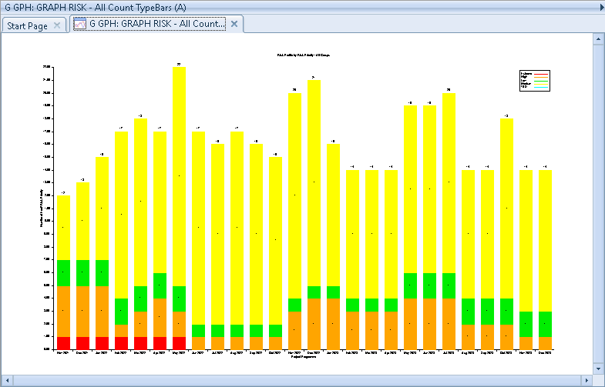
Risk Profiles: 2
Risk counts for each risk priority against time
Total of the risks’ value (cost in this case), weighted by risk likelihood, against time

Slide 21
RISK Licence 7
Cradle provides an optional Cradle-RISK module with a separate RISK licence
RISK licences are floating and dynamic, as are all other module licences
The RISK licence is used:
When editing an item of the type defined to be a risk
When generating a risk profile
Risk information can be defined and used in Cradle without the RISK module
The RISK module provides:
Ability to define RAMs and RAM inheritance down a RBS
Lookup of risk magnitude / priority / severity from a RAM
Risk profiles
One RISK licence can be shared between 3 concurrent risk users

Slide 22
Summary 8
Cradle supports all aspects of a risk management plan
Provides a RBS with any structure, any number of risk registers and risks
Any number of RAMs with automatic inheritance down the RBS
Full set of operations, including search, view, filter, edit, history, linking, traceability, coverage, reordering, adaptations, merge, split, find, replace, properties
Risks can be captured from source documents
Risks can be imported and exported
Risks can be published in user defined reports and documents
Provides full range of risk profile graphs
Have user-defined workflows so can be reviewed, baselined and subject to formal change control through Cradle’s Configuration Management System (CMS)
Available through the API and WSI

