Slide 1
Cradle for Business Analysts
Why Collaboration Tools are Not Enough
RR022/05: January 2023

Slide 2
Contents
Business Analysis
Business Analysis Information
Information Schemas
Data Structures
Traditional Agile
Integrating Agile
Tool Needs
3SL Services
Summary

Slide 3
Business Analysis 1
Types of business analysis (BA):
Strategic planning:
Identify the organisation's business needs, goals, objectives…
Business model analysis:
Define the organisation's policies and approaches to its stakeholders
For Government, types and principles of interaction with:
The public
Other parts / layers of Government
The business rules
Process design:
Document, understand and standardise, or define the organisation’s workflows
Systems analysis:
Translate the business rules and requirements into systems (typically IT)
In general, to define, design and deploy: services

Slide 4
Business Analysis: 2
Typical deliverables:
Needs, goals, objectives
ConOps: concept of operations
Business requirements
Business plan: with KPIs (key performance indicators), project plan...
Functional requirements, logical data models, use cases, work instructions, reports...
Non-functional requirements
As-is processes:
To-be processes
Data models: data concepts/requirements expressed as: ERDs, DSDs, CDs, ERA…
Architecture models: define enterprise architecture: PADs, AIDs, UML (CPDs, DPDs)…
Traceability / coverage analyses, including RTMs, VCRMs, PVMs
TEAMP: test and acceptance management plan
COMP: configuration management plan
Business case: a strategic plan containing stakeholders' risks and returns
Service definition: need, concept, architecture, resources, threat analysis (RMADS), on-boarding, operation, management, resilience, governance, off-boarding
described in: eFFBDs, PFDs, IDEF0, BPM, DFDs, ACDs, SQDs, flowcharts…

Slide 5
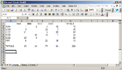
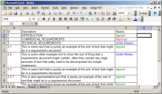
Business Analysis Information 2
Business analysis (BA) involves many sets of information:
All inter-related
All with rich and varied content
Cross references needed between these sets:
To provide dependency analyses:
Traceability, forward through the sets
Coverage, backwards through the sets
Transitive, indirect relationships between sets
Via intermediate sets of information
Schema is user-defined description of BA information:
Database is a collection of datasets
Each dataset is a collection of items, each of a user-defined item type
Items contain attributes, each of a user-defined data type
Items linked by cross references (links)
Links optionally typed
Links contain attributes, used to parametise / justify / explain relationships
Links within and between sets are 1:1, 1:N and M:N
Will want re-use / sharing of data between projects, perhaps want libraries
Item

Slide 6
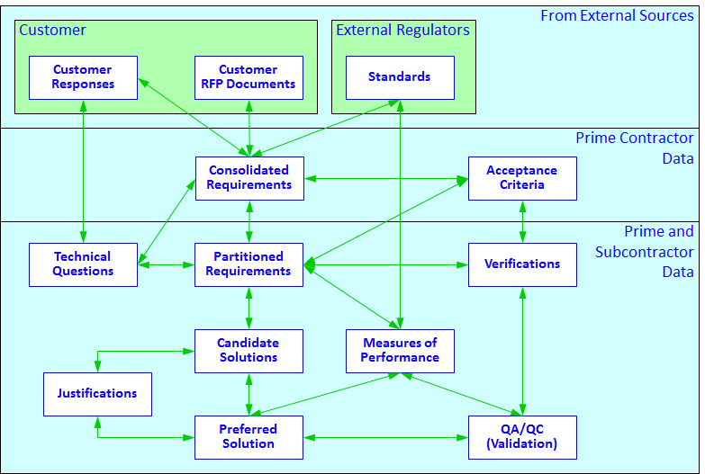
Information Schemas 3
Example schema: bid analysis

Slide 7
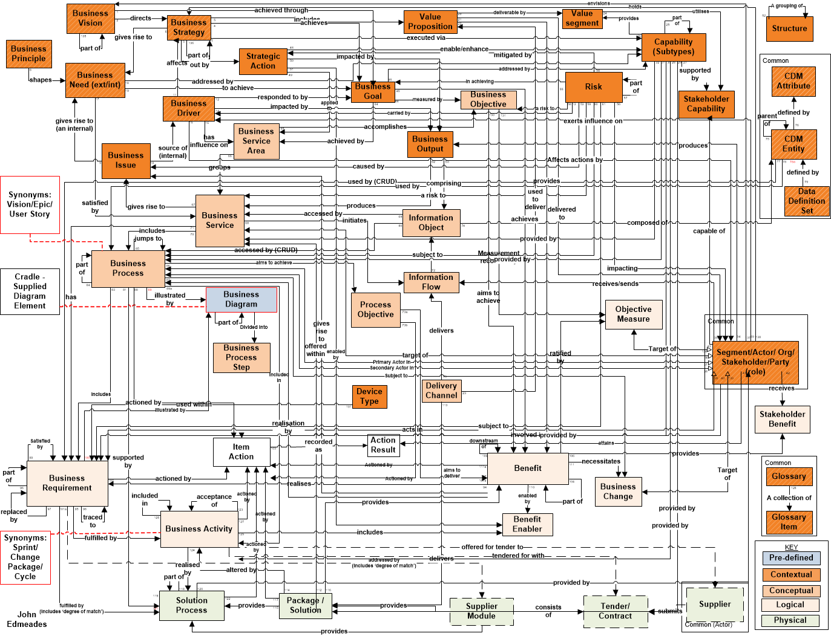
Information Schemas: 2
Example schema: business analysis for Government department

Slide 8
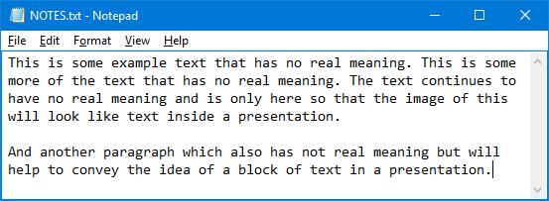
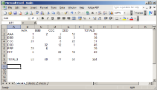
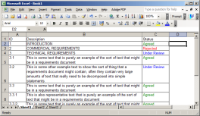
Data Structures 4
Linear list (rare):
Hierarchy (common):
Graph (common):
Item
Item
Item
Item
Item
Item
Item
Item
Item
Item
Item
Item
Item
Item
Item
Item
Item
Item
Item
Item
Item

Slide 9
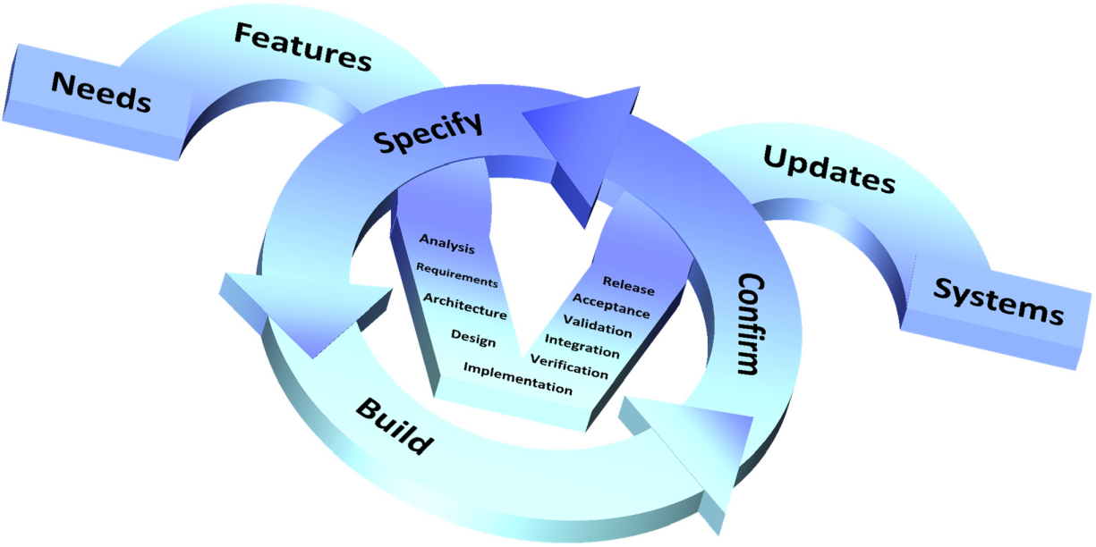
Traditional Agile 5
Agile is a long-established implementation technique, dating from the late 1970s...
… although much has been written to suggest it is new …
It is a simple, powerful, concept:
Prioritised list of work (feature backlog)
Often expressed in user stories
Do work in short sprints or iterations:
Each uses some/all of the V model
Each ends with a working system / service
In the past, the first iterations’ product called the null system
So:
The system / service is always available
That, over time, becomes increasingly: complete, mature, flexible ...
Essentially, don’t wait to the end to have something that works

Slide 10
Implementing Agile 6
Agile is more than a simple prioritised list of features/defects, each:
Allocated to iterations, people …
With a list of tests / issues
Because:
It exists in a business analysis context
User stories are inadequate inputs – not requirements – are simple summaries
Each iteration must update: architecture, designs, tests, risks, processes …
Else, it would be extreme programming – polite term for hacking code
Collaboration tools

Slide 11
Tool Needs 7
Tools to support business analysis and agile must provide:
Multiple item types with rich data (text, images, Word / Excel / Visio documents …)
Load variety of external data, tracking multiple versions, linked to all BA data
Modelling: process, architecture, functional, data
Implementation and test support, for example using agile methods
Rich cardinality for linking of all items: 1:1, 1:N, M:N
Virtually no data is linear
Most data is hierarchical
NFRs, models and test data are graphs (M:N)
Rich publishing, tracking multiple versions, linked into all BA data
Collaboration – users, teams, alerts, task lists, WBS
Authentication, authorisation, tracking
Management, metrics, KPIs, governance
Configuration management and control – reviews, baselines, process frameworks

Slide 12
3SL Services 8
3SL provides Cradle software and related services
Cradle meets all tool needs for BA
Packages available: Cradle + schema + optional training + optional consultancy
Includes Business Analysis
Available in-house or SaaS:
SaaS services include UK Government’s G-Cloud:
https://www.applytosupply.digitalmarketplace.service.gov.uk/g-cloud/search?q=%22Structured%20Software%20Systems%20Ltd.%22
For IL0 to IL3 (OFFICIAL-SENSITIVE) – only such SaaS services in G-Cloud
Full RMADS in place, ATO from CLAS (CESG based) accreditation
3SL SaaS product: 3SL Cradle Business Analysis
Description: https://www.applytosupply.digitalmarketplace.service.gov.uk/g-cloud/services/978358657746064
Service definition: https://assets.applytosupply.digitalmarketplace.service.gov.uk/g-cloud-13/documents/586675/978358657746064-service-definition-document-2022-05-18-0551.pdf

Slide 13
Summary 9
Business analysis is complex
Uses / creates many sets of information – all inter-related, all complex
So traceability and coverage are vital
Agile processes often described as lists: user stories, tests …
Collaboration tools often used for this simplistic agile
Business analysis and agile only valid with full, complex information
That collaboration tools cannot manage
So RM/SE tools needed to support business analysis – agile / phase / V / waterfall
Cradle, from 3SL

